Slide 1
Introduction to BPT Framework
Elaborated by: Douglas Garcia
douglas@ideliver-inc.com

Slide 2
Agenda
Introduction to ALM and BPT
HP BPT under ALM 11.52
Explanation of component
Roles
Metodology
Pro's and Con's of Component based test design / testing.
Demo
Excercise

Slide 3


HP ALM
Application Lifecycle Management
Testing
Functional Testing
Manual Testing
Test Planning
Performance Testing
Defect Manager
Dashboard
Requirements Management
Integration with HP tools
Integrations with non HP tools

Slide 4



New HP Business Process Testing 11.52
Process
Layer
People
Process
Information
Features
Unified IDE–BPT tests within UFT
Abstracted implementations – manual, automated, both
Sprinter integration
Problem it Solves
Use within UFT and Sprinter
Visual business process flows
Switch between manual/auto
Sprinter records to BPT component
Benefits
Speed adoption of Framework
Test method flexibility
Rapid flow and component creation
Investment protection – leverage manual and automated efforts
Notes:
Key Differentiators in HP BPT :
One-stop-testing shop integration in the unified IDE: The unified IDE with HP Unified Functional Testing provides a “one stop shop” for GUI, API and Business process testing, useable by developers and testers alike. For HP ALM and HP Quality Center users, they can use HP Business Process testing to create and run business process tess from within UFT in addition to creating individual GUI and API business components. For the full unified experience, HP ALM or HP Quality Center with BPT and HP UFT should be used.
Ease of use/speed of creation -- A new design canvas designed to cleanly and visually enable rapid assembly of business process flows consisting of either HP Sprinter manual or HP UFT automated test components.
Test method flexility-- Abstracted Implementations – BPT components can now consist of manual test cases, automated test scripts or a combination with support for abstracted implementations. Inside BPT the tester can switch between manual and automated (is it the tester that switches or the tool that triggers the switch?) and BPT keeps track of how many of each type are run. (why do we care?)
Time savings and re-use of manual testing efforts -- HP Sprinter Integration – Now with BPT from within the HP ALM or QC test planning module, the manual tester can record, replay and now create BPT components while inside HP Sprinter.

Slide 5
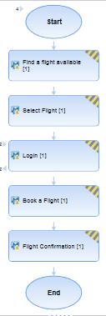
HP ALM Business Process Testing
Framework for QA Organizations
Build frameworks to maximize reuse of testing components
BPT is: fast, efficient, Organized

Slide 6

Business Process Testing Benefits
Design quality assurance tests
Script-free environment
Reusable business components and flows
Design quality assurance tests from the design of a high-level test structure down to the design of actual steps

Slide 7
Business Process Testing Benefits(cont)
Not programming background needed.
Reduces the need for repeating steps
ALM enables you to create manual and automated BPT tests.

Slide 8
Business Process testing Benefits(cont)
Applications can be tested manually by non-technical users
Not coding skills needed to create steps
BPT tests support version control
Documentation containing information about BPT test can be generated

Slide 9
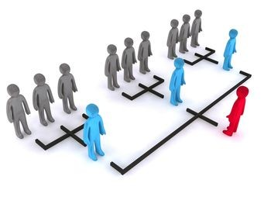
Roles
The Business Process Testing model is role-based
Roles are flexible

Slide 10

Subject Matter Experts
Determine the business processes to test.
Create business components and steps.
Create flows and business process tests.
Define data for iterations and configurations.

Slide 11
Automation Engineers
The role is only applied for automated tests.
Are experts in automated testing tools

Slide 12
Other Roles
QA Testers
ALM administrators

Slide 13
Choosing Methodologies
Bottom-up Methodology
Top-down Methodology
The business processes in the organization are clearly defined.
Users are new to Business Process Testing.
Business process tests, which contain flows and/or business components
Flows, which contain business components
Business components, which contain manual and/or automated steps

Slide 14
Methodologies Phases
Top-Down Methodology
Bottom-up Methodology
High-level design
Mid-level design
Low-level implementation
Component Specification
Test Planning
Data Handling
Test Execution

Slide 15

Key features for manual testing
Parameterization
Iterations
Maintenance

Slide 16

What is a component?
A business process.
It Validates and optimize flows.
Features available without modifying any code.

Slide 17
Components with Manual Content
Use the Manual Implementation tab to create a manual business component
Manual steps represents operations
Testers performs the steps defined in the manual component when it runs.

Slide 18

HP ALM Business components
Pro’s
Con’s
Easy maintenance without affecting the code
Single point of maintenance for all elements.
High reusability
Testing multiple flows
Anyone can create tests
Some granularity might become cumbersome.

Slide 19

Demo

Slide 20

Exercise

Slide 21
Questions?

